Slide 1
Data Analysis
Secondary analysis of three large scale social surveys in the UK
Beyond Us and Them
Understanding Society
Community Life
Approx. 77,000 participants over a time span of 7 years (2014-2021)
#PowerOfConnection
Notes:
Dom - is this about right in layperson’s language?
Need to t

Slide 2
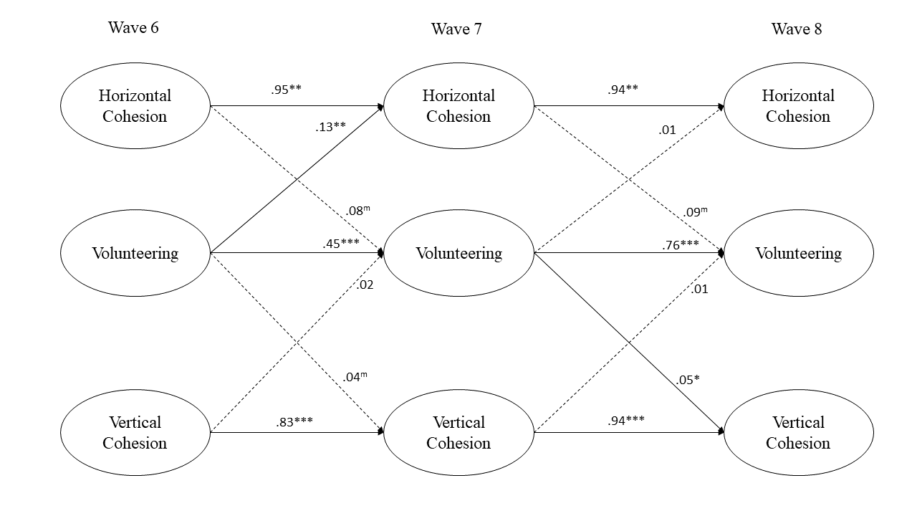
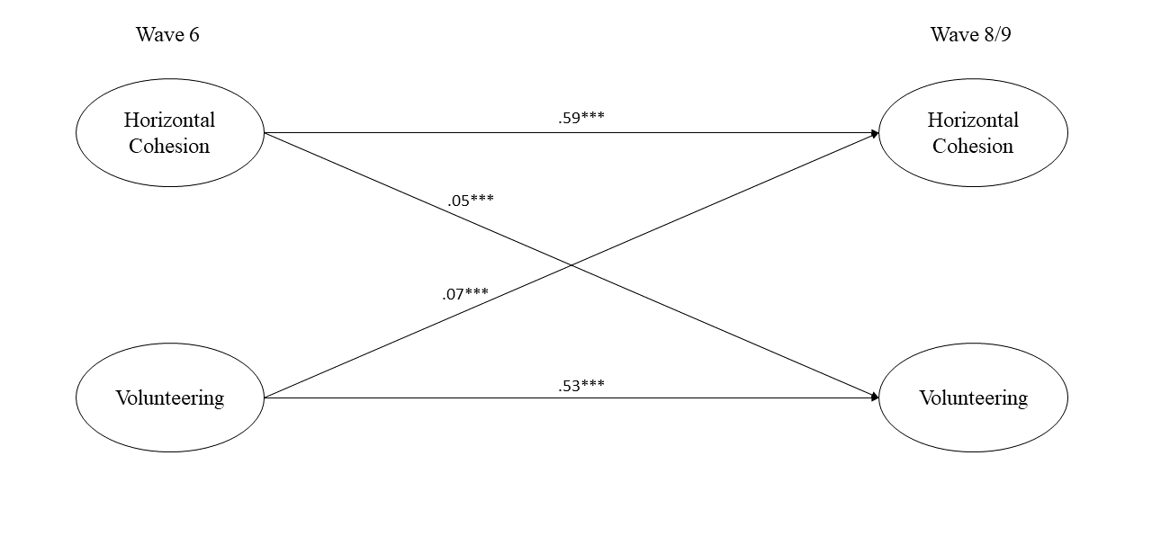
The Relationship Between Cohesion and Volunteering
Evidence for a causal and bi-directional relationship
Beyond Us and Them
Understanding Society
#PowerOfConnection
Notes:
Dom - is this about right in layperson’s language?
Need to t

Slide 3
The Importance of Place
The is substantial variation in levels of cohesion:
Between different places
Between individuals who live in the same place
Interventions will need to be sensitive to the local context and understand the needs of the local population
The link between cohesion and volunteering is largely consistent between different places
#PowerOfConnection
Notes:
Dom - is this about right in layperson’s language?
Need to t

Slide 4
Domains of Volunteering
Formal volunteering had a stronger impact on cohesion than informal volunteering
However, informal volunteering may be more accessible
The domain of volunteering is also important
“Helping” behaviours were associated with increased cohesion (e.g., improving the local neighbourhood)
“Harm prevention” behaviours were associated with decreased cohesion (e.g., animal welfare, reducing prejudice and discrimination)
#PowerOfConnection
Notes:
Dom - is this about right in layperson’s language?
Need to t

Slide 5
Demographic Differences
Inconsistent evidence of demographic differences in rates of volunteering
At some points differences are present, at other time points they are not
Some evidence that different domains of volunteering attract different demographic groups
E.g., women were more likely to volunteer than men in animal welfare areas
#PowerOfConnection
Notes:
Dom - is this about right in layperson’s language?
Need to t

