Slide 1


The power of connection- volunteering to strengthen social cohesion
Dominic abrams, ben davies,
zoe horsham

Slide 2
Outline
1. Methodology
2. Relationship between volunteering and social cohesion
3. Informal vs. formal volunteering- effects on social cohesion
3. Causal evidence for bidirectional relationship and its moderators
4. Barriers to volunteering and overcoming barriers

Slide 3
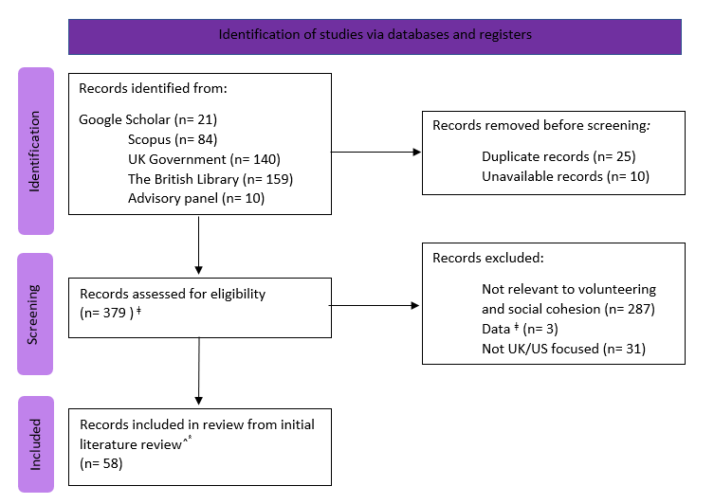
Methodology
Focus: Academic and gray literature from the UK/US in the last 23 years focusing on social cohesion and volunteering- separately or in tandem
  Academic literature- Google Scholar and Scopus
  Gray literature- British Library, UK Government website, advisory panel
Prioritised:
  Quantitative data
  Longitudinal data, to establish causality
  Large sample sizes

Slide 4
What is the relationship between volunteering and social cohesion?
Correlational evidence provides consistent support for a positive relationship between volunteering engagement and social cohesion, based on survey data, case studies and cross-sectional research
Relationship with volunteering intensity has less consistent support
Majority of evidence available is correlational which cannot speak to the direction or causality of these relationships

Slide 5
What are the conditions that mean that volunteering is more likely to lead to better connections and trust at a local level?
Zischka (2019) argues the main driver of the positive impacts of volunteering is the motivation behind it- informal volunteering, which may be driven by social pressure, has a much smaller impact on social cohesion
Informal volunteering is often directed towards our own social group, which may prevent bridging between groups and exacerbate inequality… informal volunteering may even negatively impact social cohesion in this case!
Increased resources (social and structural)
Greater capacity for informal volunteering
Primarily benefits own group

Slide 6
3. Which comes first, local volunteering infrastructure or high levels of volunteering?
Case studies, survey data and cross-sectional and longitudinal research consistently support a bidirectional relationship between social cohesion and volunteering, though this is contingent on various factors
Community connection, social contact and social ties
~perceptions of community cohesion
Social cohesion
Volunteering
Intergroup contact, social connections, neighbourhood belonging
~ active/passive volunteering ~ reach ~ motive

Slide 7
4. How do sociodemographic factors influence the kinds of volunteering people do?
Factors we have explored:
  Age
  Ethnicity
  Faith
  Disability/long-term illnesses
  Education
  Socioeconomic status
  Employment

Slide 8
4. How do sociodemographic factors influence the kinds of volunteering people do? Cont.
Age
  Mixed results- some research finds age reduces likelihood of volunteering (e.g., Johnson et al., 2018) whilst some finds no effects of age (e.g., Lee & Brundey, 2012)
  Data from the UK suggests a curvilinear relationship
    Community life survey 2020/21 found volunteering engagement increases between 25-74 years and decreases at 75+
    Helping out survey (Low et al., 2007) found volunteering engagement was highest amongst 35-64 year olds
  May be affected by confounding factors such as education level- potential cohort effects?

Slide 9
4. How do sociodemographic factors influence the kinds of volunteering people do? Cont.
Ethnicity
  Ethnic minority groups are less likely to volunteer in the US (Foster-Bey, 2008; Roto et al., 2010)
  In the UK, ethnicity has a smaller impact on volunteering (Laurence, 2009; Low et al., 2007)
  Those born outside of the UK may volunteer less (Citizenship Survey 2005)
  Trends may now be reversing in the UK- community life survey 2020/21 found a higher rate of volunteering amongst black individuals than white individuals

Slide 10
4. How do sociodemographic factors influence the kinds of volunteering people do? Cont.
Faith
  Religiosity is positively associated with volunteering in the US (Einolf & Chambre, 2011) and in the UK (Low et al., 2007), though some research has actually found a negative effect (van Tienen et al., 2010)
  Impacts of faith may differ between informal and formal volunteering- better predictor of formal volunteering than informal volunteering (Lee & Brundey, 2012)

Slide 11
4. How do sociodemographic factors influence the kinds of volunteering people do? Cont.
Disability/Long term illness
  Mixed findings
    Some suggest those with disabilities and long-term illnesses are less likely to engage in formal volunteering (Low et al., 2017), whilst others suggest they are more likely (Zischka, 2019)
    Some may use it to escape stigmas associated with unemployment related to their condition (Baines & Hardill, 2008)
    Some data also shows no impact on formal volunteering, but a positive impact on informal volunteering (Community life survey 2020/21)

Slide 12
4. How do sociodemographic factors influence the kinds of volunteering people do? Cont.
Gender
  Women seem to engage in volunteering more than men- found in the US (Einolf & Chambre, 2011; Johnson et al., 2018) and the UK (Low et al., 2007)
  Gender has less of an impact on intensity of volunteering than volunteering engagement overall (Johnson et al., 2018)
  Impacts of gender on informal volunteering is much weaker (Lee & Brundey, 2012)
  BUT… trends may be changing!
    More recent data in the UK found no impact of gender on formal volunteering but women were more likely to engage in informal volunteering at least once a month (Community life survey 2020/21)

Slide 13
4. How do sociodemographic factors influence the kinds of volunteering people do? Cont.
Education
  Those with qualifications are more likely to formally volunteer (Low et al., 2007) and those with higher levels of qualifications are even more likely to volunteer and volunteer at higher levels (Johnson et al., 2018; Lee & Brundey, 2012; Roto et al., 2014)
  Impact of education on informal volunteering less clear- some research suggests it has very little influence (Lee & Brundey, 2012)

Slide 14
4. How do sociodemographic factors influence the kinds of volunteering people do? Cont.
Socioeconomic status
  Those in less deprived areas volunteer more (Community life survey 2020/21)
  A potential curvilinear relationship between SES and volunteering (Lee & Brundey, 2010) with highest groups volunteering less
  SES seems to have little impact on intensity of volunteering (Johnson et al., 2018)

Slide 15
4. How do sociodemographic factors influence the kinds of volunteering people do? Cont.
Employment
  Those in employment generally volunteer more than those who are unemployed in the US (Einolf, 2010; Johnson et al., 2018)
  Those who work part time are more likely to volunteer than those who work full time (Einolf, 2010; Einolf & Chambre, 2011)
  But the community life survey 2020/21 found similar rates of formal volunteering between employed and unemployed individuals in the UK (18% vs 21%) and higher rates of informal volunteering amongst unemployed individuals
  Reason for unemployment may play a role- stay at home partners volunteer more than those with illnesses/disabilities (Low et al., 2007)

Slide 16
4. What are the barriers to volunteering? How can volunteering be encouraged particularly in groups less likely to volunteer?
Most common barriers to volunteering are:
  Lack of time
  Heterogeneity in community and volunteering group
  Perceived lack of skills (men)
  Perceived lack of safety (women)
  Lack of awareness of opportunities to volunteer
Ways to increase volunteering include:
  Providing more diverse opportunities to meet people’s wants and needs
  Overcoming structural barriers e.g., covering travel expenses
  Timebanks- particularly effective for those less likely to volunteer e.g., ethnic minorities, those with illnesses/disabilities
  Key takeaway: Approaches to increase volunteering must consider their target groups, as different barriers affect different groups to varying extents

Slide 17
6. What relationship is there between different kinds of volunteering?
Research in the US and UK supports a positive relationship between formal and informal volunteering (Choi et al., 2007; Lee & Brundey, 2012; Zischka, 2019)
Zischka (2019) argues this positive relationship is driven by an individual’s underlying prosocial motivation and perceptions of trust
It may be worth exploring the relationships between specific volunteering behaviours e.g., charity shop work vs. food bank volunteering in the future

